Slide 1
Final Project Topic
Sandra Leal

Slide 2
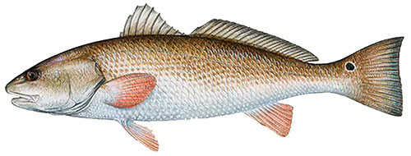
Data Background
Red Drum capture data provided by Texas Parks and Wildlife utilizing different net types
Gillnet, Bag Seine, Bay Trawl
Records from 2008 to 2018
Data examples:
Location
Length class
Month, Year
Counts per net deployment

Slide 3
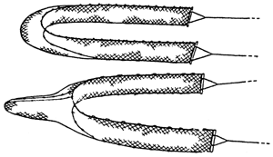
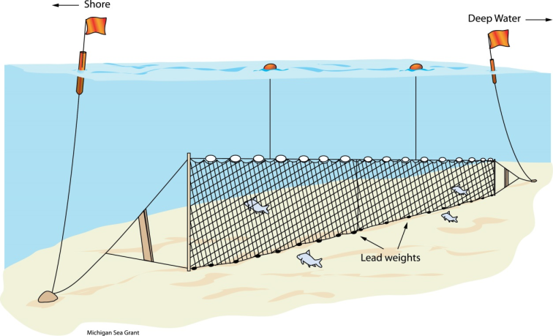
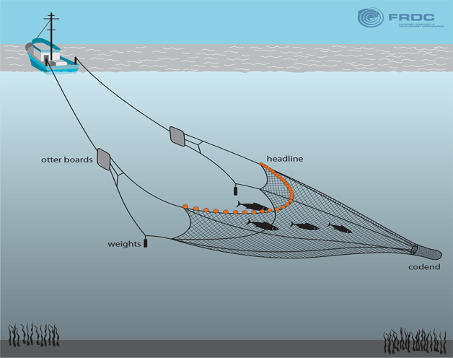
Net Types
Bag Seine
Gill Net
Bay Trawl

Slide 4
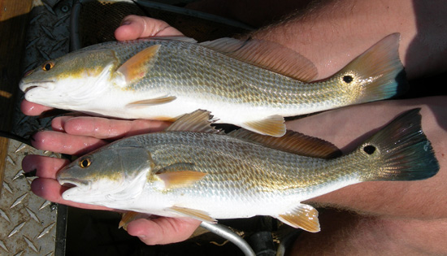
Topic Idea
With data provided, model which areas have the highest Red Drum capture counts/ which net type was the most effective in capturing Red Drum overall

